Slide 1
Certification and Licensure Division
March 6, 2017

Slide 2
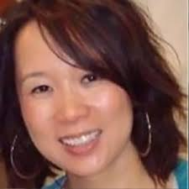
Outgoing Division Chair
A huge thank you to Ada Woo for her service to the Certification and Licensure Division!
Ada Woo, PhD
Director of Measurement and Testing
(National Council of State Boards of Nursing)

Slide 3
Agenda
Overview of ATP Structure and Divisions
2017 Division Leadership
2017 Innovations Featured C/L Speakers
Division Subcommittees and Activities
  Presentation by Recertification and Renewal
  Presentation by Accessibility and Accommodations
Open Discussion

Slide 4
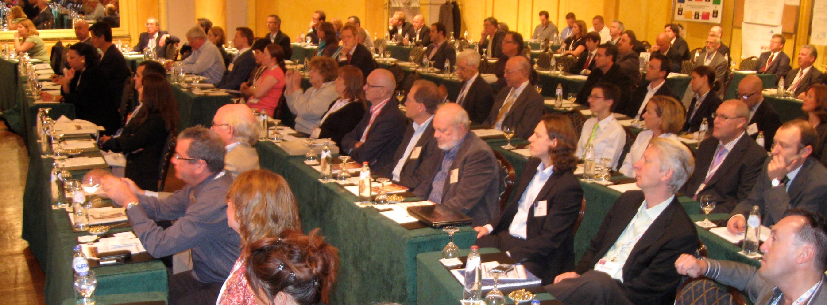
ATP’s Structure
ATP was created to allow both large and small testing companies to sit down together at a round table to work out the challenges that face the testing community as a whole - across different sizes and interest areas…and now among countries and even continents.

Slide 5
ATP’s Membership is Comprised of Four Regional Divisions…
ASIA
EUROPE
INDIA
NORTH AMERICA

Slide 6
…and Five Practice Area Divisions
Certification/Licensure
Clinical
Education
Industrial/Organizational
Workforce Skills

Slide 7
2017 Division Leadership
Chair:
Dawn Gibas, PhD
Assessment Specialist
(American Society of Agronomy/Soil Science Society of America)
dgibas@sciencesocieties.org
Vice-Chair:
Philip Koneman, PhD
Program Manager, Certification
(Autodesk)
Philip.koneman@autodesk.com
Secretary:
Liberty Munson, PhD
Principle Psychometrician and Quality Lead
(Microsoft)
Liberty.munson@microsoft.com

Slide 8
2017 Innovations C/L Division Featured Speakers
Changing the Design of Examinee Score Reports
  Rebecca Lipner, American Board of Internal Medicine
  Bradley Brossman, American Board of Internal Medicine
  9:30-10:30am Monday
  Trailblazer A
Implementing Automated Item Generation in a Large-scale Medical Licensing Examination Program: Lessons Learned
  Mark Gierl, University of Alberta
  Andre De Champlain, Medical Council of Canada
  4:30-5:30pm Tuesday
  Trailblazer C

Slide 9
Current Division Subcommittees
Accessibility and Accommodation
  New – presentation on projects for 2017
Credentialing Technology
Delivery and Administration
Low Volume Exams
Recertification and Renewal
  Business and Credentialing Subcommittee
  Recertification Subcommittee
  Presentation on combined committee work

Slide 10
Subcommittee Accomplishments in 2016
Low Volume Exams
  In collaboration with ICE, the subcommittee is developing a white paper on best practices of the development of low volume examinations.
  The subcommittee plans to complete the white paper draft in 2017.
  Innovations Conference presentation:
  Developing Guidance for Low Volume Exam Programs: a Foundation to Address the Challenges
    Dawn Gibas, ASA/SSSA
    Manny Straehle, AERE
    1:15-2:15pm Monday
    Rainmaker C

Slide 11
2016 Accomplishments (cont.)
Recertification
  Launched a survey on recertification practices in October 2016.
  The goal of this survey was to obtain a sizable response such that analyses can be conducted to identify differences in practices across key characteristics of certifying programs.
  The survey was delivered electronically to the ATP Certification and Licensure mailing list.
Business and Credentialing
  Contributed questions for inclusion in the Recertification subcommittee survey.
Presentation on the survey and next steps…

Slide 12
Recertification and Renewal Subcommittee Co-Chairs
Amin Saiar, PhD
Senior Psychometrician
PSI Services, LLC
Michael Peabody, PhD
Psychometrician
ABFM
Kevin Bradley, PhD
Director, Credentialing Services
HumRRO

Slide 13
Recertification and Renewal Subcommittee Survey Summary
Recertification subcommittee with input from the Business of Certification subcommittee
Delivered via Survey Monkey to all members of the Certification and Licensure Division
Active between October 1, 2016 and February 1, 2017.
  Survey to be opened again soon.
36 members responded.

Slide 14
Survey Summary (cont.)
Topics included:
  Industry/Field
  Candidate motivation for credential
  Requirements for Recertification/Renewal
    Self-Assessment, Continuing Ed, or something else
  Market Trends
  Services provided other than the credential
  Candidate engagement

Slide 15
Survey Summary (cont.)
For copies of the results, please contact:
  Amin Saiar (amin@psionline.com)
  Michael Peabody (mpeabody@theabfm.org)
  Kevin Bradley (kbradley@humrro.org)

Slide 16
Accessibility and Accommodations Subcommittee
John A. Hosterman, Ph.D.
Chief of Accessibility Services
Paradigm Testing
john@paradigmtesting.com
Joshua Stopek, CPA
Senior Technical Manager - Research
AICPA
Joshua.Stopek@aicpa-cima.com

Slide 17
Accessibility/Accommodations Subcommittee
Issues/Projects for 2017:
The Fire Alarm Syndrome
The Perils of the “Approve Everything” Model

Slide 18
Accessibility/Accommodations Subcommittee
1. The Fire Alarm Syndrome
Most organizations (except the largest) do not want to devote a lot of time, $, or labor into dealing with a hypothetical problem in advance.
When an accommodations situation escalates into a crisis, there is significant legal and business risk if the situation is not handled properly.
Organizations need help developing strategies for dealing with escalations before they become crises.

Slide 19
Accessibility/Accommodations Subcommittee
2. The Perils of the “Approve Everything” Model
Some organizations believe that the "safest" approach to handling accommodations requests is to just approve everything and anything.
While this approach may-- at least on the surface-- reduce legal risk, other risks may be increased, including test security risks, test validity risks, and business risks. These other risks can themselves increase legal risk.
Organizations need to fully appreciate all of the risks of this Model, not only the legal risks.

Slide 20
Accessibility/Accommodations Subcommittee
“The Fire Alarm Syndrome” & “The Perils of the Approve Everything Model”: Work in Progress
Outlines of each problem– and strategies for avoiding the problem– are already drafted.
Solicit input from C/L Division.
Present both topics at ICE and solicit input.
Accessibility & Accommodations Subcommittee to flesh out the outlines for Whitepapers, and/or ATP 2018 presentations.

Slide 21
Thank you!
Thoughts?
Questions?
Ideas?
Want to help?

